Slide 1
Mining Facebook, Analyzing pages, Examining friendships, and more

Slide 2
Introduction
Facebook is the heart of the social web, with more than half if its 1 billion users active each day updating statuses, posting photos, exchanging messages, etc.
Facebook’s API provides incredible opportunities to synthesize data into information and get valuable insights.

Slide 3
Main Concepts
Facebook’s social graph API and how to make API requests.
Open Graph protocol and its relationship to Facebook’s Social Graph.
Analysing likes from Facebook pages and from facebook friends.
Techniques such as clique analysis for analysing the social graphs.
Visualising social graphs with the D3 Javascript library.

Slide 4
Exploring Facebook’s Social Graph API
What is API?
API is the acronym for Application Programming Interface, which is a software intermediary that allows two applications to talk to each other.
Ex: Kitchen-waiter-customer/ the booking website.
Facebook has its own API-Social Graph API.

Slide 5
Social Graph API
As a social web miner, the only way that you can access a Facebook user’s account data is by registering an application and using that application as the entry point into the Facebook developer platform(developers.facebook.com). Moreover, the only data that’s available to an application is whatever the user has explicitly authorized it to access.
For example, as a developer writing a Facebook application, you’ll be the user who’s logging into the application, and the application will be able to access any data that you explicitly authorize it to access.

Slide 6
Terms
Access token:
When someone connects with an app using Facebook Login, the app will be able to obtain an access token which provides temporary, secure access to Facebook APIs. An access token(OAuth token-commonly used as a way for Internet users to grant websites or applications access to their information on other websites but without giving them the passwords) is an opaque string that identifies a user, app, or Page and can be used by the app to make graph API calls.
/{node-id}? fields=<first-level>{<second-level>}

Slide 7
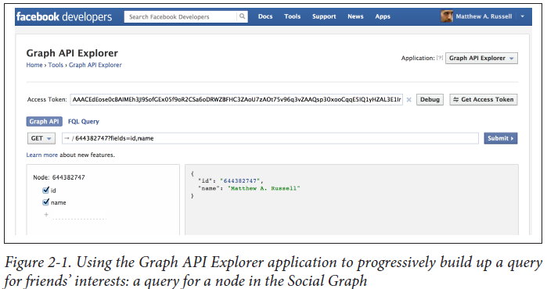

Slide 8
Terms
Node IDs
The basis of a query is a node with an ID corresponding to a user who is the logged in user of the graph explorer. The “id” and “name”values for a node are called fields.
Connection constraints
You can modify the original query with a “friends”, by clicking on the + and then scrolling to “friends” in the “connections” pop-up menu. The “friends” connections that appear in the console represent nodes that are connected to the original query node. At this point, you could click on any of the blue ID fields in these nodes and initiate a query with that particular node as the basis.

Slide 9
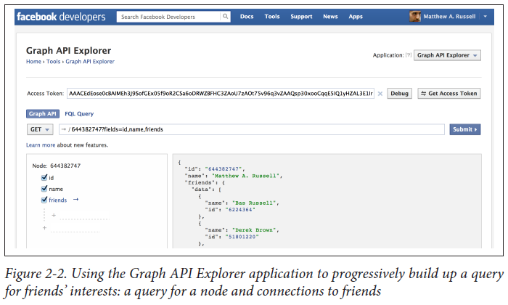

Slide 10
Terms
Likes constraints
A further modification to the original query is to add “likes” connections for each of your friends, as shown in Figure 2-3. Before you can retrieve likes connections for your friends, however, you must authorize the Graph API Explorer application to explicitly access your friends’ likes by updating the access token that it uses and then approve this access, as shown in Figure 2-4.
The Graph API Explorer allows you to easily authorize it by clicking on the Get Access Token button and checking the “friends_likes” box on the Friends Data Permissions tab.

Slide 11
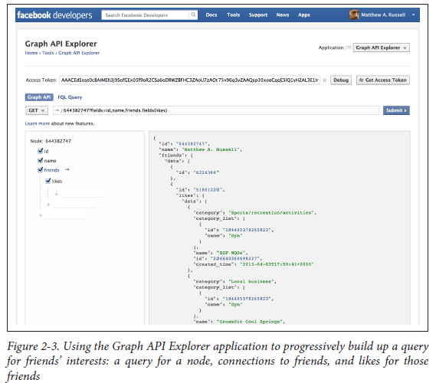

Slide 12
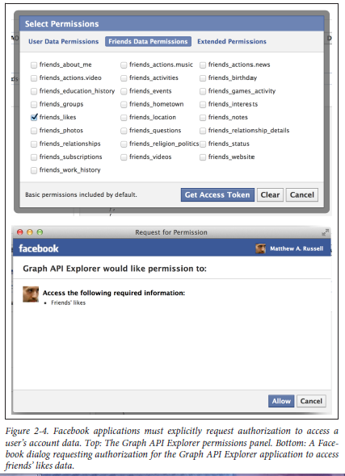

Slide 13
Terms
Debugging
The Debug button can be useful for troubleshooting queries that you think should
be returning data but aren’t doing so based on the authorizations associated with the access token.
JSON response format
The results of a Graph API query are returned in a convenient JSON format that can be easily manipulated and processed.

Slide 14
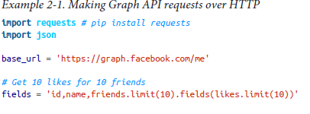
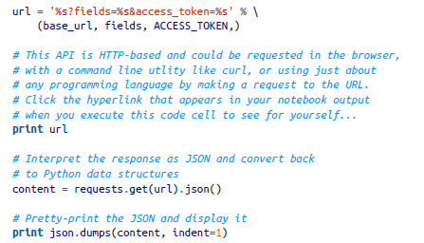
Ex-1:Making Graph API requests over HTTP

Slide 15
Understanding the Open Graph Protocol

Slide 16
Introduction
Facebook unveiled something called the Open Graph protocol (OGP) back in April 2010.
OGP is a mechanism that enables developers to make any web page an object in Facebook’s Social Graph by injecting some RDFa metadata into the page.

Slide 17
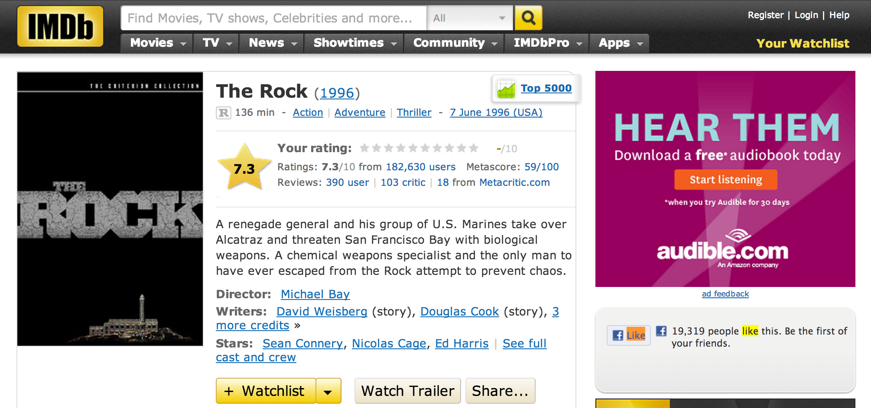
Example
Figure 2-5. An IMDb page featuring an implementation of OGP for The Rock

Slide 18
Implementation of OGP
XHTML document that uses namespaces looks something like this:
<html xmlns:og="http://ogp.me/ns#">
<head>
<title>The Rock (1996)</title>
<meta property="og:title" content="The Rock" />
<meta property="og:type" content="movie" />
<meta property="og:url" content="http://www.imdb.com/title/tt0117500/" />
<meta property="og:image" content="http://ia.media-imdb.com/images/rock.jpg" />
...
</head>
...
</html>

Slide 19
Implementation
At its core, querying the Graph API for Open Graph objects is incredibly simple:
For example, fetching the URL: http://graph.facebook.com/http://www.imdb.com/title/tt0117500 in your web browser would return this response:
{
"id": "114324145263104",
"name": "The Rock (1996)",
"picture": "http://profile.ak.fbcdn.net/hprofile-ak-snc4/hs344.snc4/...jpg",
"link": "http://www.imdb.com/title/tt0117500/",
"category": "Movie",
"description": "Directed by Michael Bay. With Sean Connery, ...",
"likes" : 3
}

Slide 20
Implementation
you explicitly request additional metadata for an object in the page by appending the query string parameter metadata=1 to the request. Here is a sample response for the query:
https://graph.facebook.com/114324145263104?metadata=1

Slide 21
Implementation
metadata": {
"connections": {
"feed": "http://graph.facebook.com/http://www.imdb.com/title/...",
"posts": "http://graph.facebook.com/http://www.imdb.com/title/...",
"tagged": "http://graph.facebook.com/http://www.imdb.com/title/...",
"statuses": "http://graph.facebook.com/http://www.imdb.com/title/...",
"links": "http://graph.facebook.com/http://www.imdb.com/title/...",
"notes": "http://graph.facebook.com/http://www.imdb.com/title/...",
"photos": "http://graph.facebook.com/http://www.imdb.com/title/...",
"albums": "http://graph.facebook.com/http://www.imdb.com/title/...",
"events": "http://graph.facebook.com/http://www.imdb.com/title/...",
"videos": "http://graph.facebook.com/http://www.imdb.com/title/...",
},
The items in metadata.connections are pointers to other nodes in the graph that you can crawl to get to other intriguing bits of data.

Slide 22
Analyzing Social Graph Connections

Slide 23
Introduction
An official Python SDK for the Graph API is a community fork of that repository previously maintained by Facebook and can be installed using:
pip install facebook-sdk.

Slide 24
Implementation Methods
Few key methods from the GraphAPI class that you need to know about in order to use the Graph API to fetch data:
1-get_object(self, id, **args)
Example usage: get_object("me", metadata=1)
2-get_objects(self, id, **args)
Example usage: get_objects(["me", "some_other_id"], metadata=1)
3-get_connections(self, id, connection_name, **args)
Example usage: get_connections("me", "friends", metadata=1)
4-request(self, path, args=None, post_args=None)
Example usage: request("search", {"q" : "social web", "type" : "page"})

Slide 25
Example 2-2. Querying the Graph API with Python
import facebook # pip install facebook-sdk
import json
# A helper function to pretty-print Python objects as JSON
def pp(o):
print json.dumps(o, indent=1)
# Create a connection to the Graph API with your access token
g = facebook.GraphAPI(ACCESS_TOKEN)

Slide 26
Example
# Execute a few sample queries
print '---------------'
print 'Me'
print '---------------'
pp(g.get_object('me'))
print
print '---------------'
print 'My Friends'
print '---------------'
pp(g.get_connections('me', 'friends'))
print
print '---------------'
print 'Social Web'
print '---------------'
pp(g.request("search", {'q' : 'social web', 'type' : 'page'}))
to query for information about you, information about your friends, and the term social web.

Slide 27
Sample Output
---------------
Me
---------------
{
"last_name": "Russell",
"relationship_status": "Married",
"locale": "en_US",
"hometown": {
"id": "104012476300889",
"name": "Princeton, West Virginia"
},
"quotes": "The only easy day was yesterday.",
"favorite_athletes": [
{
"id": "112063562167357",
"name": "Rich Froning Jr. Fan Site"
}
],

Slide 28
Sample Output
---------------
My Friends
---------------
{
"paging": {
"next": "https://graph.facebook.com/644382747/friends?...",
},
"data": [
{
"name": "Bas Russell",
"id": "6224364"
},
...
{
"name": "Jamie Lesnett",
"id": "100002388496252"
}
]
}

Slide 29
Sample Output
---------------
Social Web
---------------
{
"paging": {
"next": "https://graph.facebook.com/search?q=social+web&type=page...",
},
"data": [
{
"category": "Book",
"name": "Mining the Social Web“,
"id": "146803958708175"
},
{
"category": "Internet/software",
"name": "Social & Web Marketing",
"id": "172427156148334"
}

Slide 30
Analyzing Facebook Pages

Slide 31
Introduction
Facebook started out as more of a pure social networking site.
It quickly adapted to take advantage of the market needs.
Fast-forward a few years, and now businesses, clubs, books, and many other kinds of nonperson entities have Facebook pages with a fan base.
Facebook pages are a powerful tool for businesses to engage their customers, and Facebook has gone to some lengths to provide tools that allow Facebook page administrators to understand their fans.

Slide 32
ANALYSIS
• How popular is the page?
• How engaged are the page’s fans?
• Are any of the fans for the page particularly outspoken and participatory?
• What are the most common topics being talked about on the page?

Slide 33
Your imagination is the only limitation to what you can ask of the Graph API for a Facebook page when you are mining its content for insights and questions should get you headed in the right direction.

Slide 34
For any of the items in the search results, we could use the ID as the basis of a graph query through get_object with an instance of facebook.GraphAPI. If you don’t have a numeric string ID handy, just use the page name (such as “MiningTheSocialWeb”) that appears in the URL bar of your browser when you visit the page.

Slide 35
QUERY
# Get an instance of Mining the Social Web
# Using the page name also works if you know it.
# e.g. 'MiningTheSocialWeb' or 'CrossFit'
mtsw_id = '146803958708175'
pp(g.get_object(mtsw_id))

Slide 36
RESULT
{
"category": "Book",
"username": "MiningTheSocialWeb",
"about": "Analyzing Data from Facebook, Twitter, LinkedIn, and Other Social...",
"talking_about_count": 22,
"description": "Facebook, Twitter, and LinkedIn generate a tremendous ...",
"company_overview": "Like It here on Facebook!\n\nFollow @SocialWebMining...",
"release_date": "January 2011",
"can_post": true,
"cover": {
"source": "https://sphotos-b.xx.fbcdn.net/...",
"cover_id": 474206292634605,
"offset_x": -41,
"offset_y": 0
},

Slide 37
"mission": "Teaches you how to...\n\n* Get a straightforward synopsis of ...",
"name": "Mining the Social Web",
"founded": "January 2011",
"website": "http://amzn.to/d1Ci8A",
"link": "http://www.facebook.com/MiningTheSocialWeb",
"likes": 911,
"were_here_count": 0,
"general_info": "Analyzing Data from Facebook, Twitter, LinkedIn, ...",
"id": "146803958708175",
"is_published": true
}

Slide 38
The interesting analytical results from the query response are the book’s talk
ing_about_count and like_count.

Slide 39
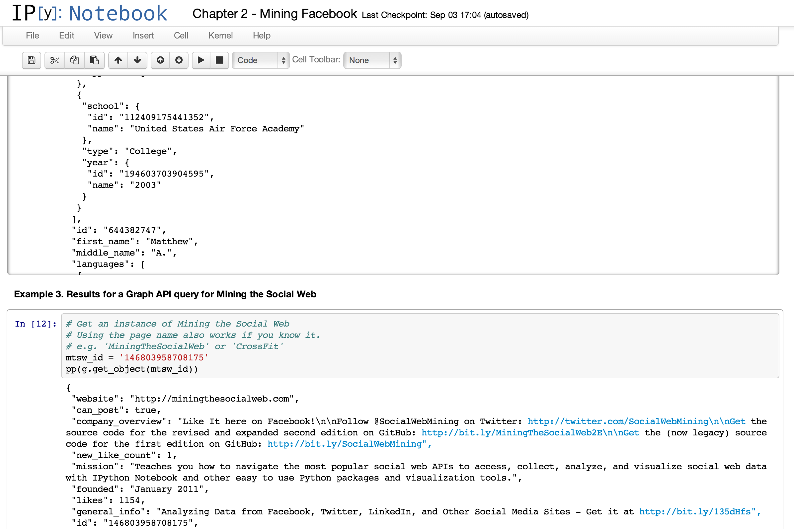

Slide 40
Comparing likes between Coke and Pepsi fan pages:
# Find Pepsi and Coke in search results
pp(g.request('search', {'q' : 'pepsi', 'type' : 'page', 'limit' : 5}))
pp(g.request('search', {'q' : 'coke', 'type' : 'page', 'limit' : 5}))
# Use the ids to query for likes
pepsi_id = '56381779049' # Could also use 'PepsiUS'
coke_id = '40796308305' # Could also use 'CocaCola'

Slide 41
# A quick way to format integers with commas every 3 digits
def int_format(n): return "{:,}".format(n)
print "Pepsi likes:", int_format(g.get_object(pepsi_id)['likes'])
print "Coke likes:", int_format(g.get_object(coke_id)['likes'])
The results are somewhat striking:
Pepsi likes: 9,677,881
Coke likes: 62,735,664

Slide 42
Querying a page for its “feed” and “links” connections
pp(g.get_connections(pepsi_id, 'feed'))
pp(g.get_connections(pepsi_id, 'links'))
pp(g.get_connections(coke_id, 'feed'))
pp(g.get_connections(coke_id, 'links'))

Slide 43
• Are there any topics or special interests that are especially pronounced within your social network?
• Does your social network contain many mutual friendships or even larger cliques?
• How well connected are the people in your social network?
• Are any of your friends particularly outspoken or passionate about anything you might also be interested in learning more about?

Slide 44
Querying for all of your friends’ likes
# First, let's query for all of the likes in your social
# network and store them in a slightly more convenient
# data structure as a dictionary keyed on each friend's
# name. We'll use a dictionary comprehension to iterate
# over the friends and build up the likes in an intuitive
# way, although the new "field expansion" feature could
# technically do the job in one fell swoop as follows:
#
# g.get_object('me', fields='id,name,friends.fields(id,name,likes)')
#
# See Appendix C for more information on Python tips such as
# dictionary comprehensions
friends = g.get_connections("me", "friends")['data']
likes = { friend['name'] : g.get_connections(friend['id'], "likes")['data']
for friend in friends }
print likes

Slide 45
Calculating the most popular likes among your friends
# Analyze all likes from friendships for frequency
# pip install prettytable
from prettytable import PrettyTable
from collections import Counter
friends_likes = Counter([like['name']
for friend in likes
for like in likes[friend]
if like.get('name')])
pt = PrettyTable(field_names=['Name', 'Freq'])
pt.align['Name'], pt.align['Freq'] = 'l', 'r'
[ pt.add_row(fl) for fl in friends_likes.most_common(10) ]
print 'Top 10 likes amongst friends'
print pt

Slide 46
Result:
Top 10 likes amongst friends
+----------------------------------------+------+
| Name | Freq |
+----------------------------------------+------+
| Crossfit Cool Springs | 14 |
| CrossFit | 13 |
| The Pittsburgh Steelers | 13 |
| Working Out | 13 |
| The Bible | 13 |
| Skiing | 12 |
| Star Trek | 12 |
| Seinfeld | 12 |
| Jesus | 12 |
+----------------------------------------+------+

Slide 47
Calculating the most popular categories for likes among your friends
# Analyze all like categories by frequency
friends_likes_categories = Counter([like['category']
for friend in likes
for like in likes[friend]])
pt = PrettyTable(field_names=['Category', 'Freq'])
pt.align['Category'], pt.align['Freq'] = 'l', 'r'
[ pt.add_row(flc) for flc in friends_likes_categories.most_common(10) ]
print "Top 10 like categories for friends"
print pt

Slide 48
Top 10 like categories for friends
+----------------------------------+------+
| Category | Freq |
+---------------------------------+------+
| Musician/band | 62 |
| Book | 46 |
| Movie | 43 |
| Interest | 40 |
| Tv show | 31 |
| Public figure | 31 |
| Local business | 25 |
| Community | 24 |
| Non-profit organization | 21 |
| Product/service | 17 |
+---------------------------------+------+

Slide 49
Calculating the number of likes for each friend and sorting by frequency
# Build a frequency distribution of number of likes by
# friend with a dictionary comprehension and sort it in
# descending order
from operator import itemgetter
num_likes_by_friend = { friend : len(likes[friend])
for friend in likes }
pt = PrettyTable(field_names=['Friend', 'Num Likes'])
pt.align['Friend'], pt.align['Num Likes'] = 'l', 'r'
[ pt.add_row(nlbf)
for nlbf in sorted(num_likes_by_friend.items(),
key=itemgetter(1),
reverse=True) ]
print "Number of likes per friend"
print pt

Slide 50
Number of likes per friend
+--------------------+-----------+
| Friend | Num Likes |
+--------------------+-----------+
| Joshua | 187 |
| Derek | 146 |
| Heather | 84 |
| Rick | 69 |
| Patrick | 42 |
| Bryan | 38 |
| Ray | 17 |
| Jamie | 14 |
| ... | ... |
| Bas | 0 |
+--------------------+-----------+

Slide 51
Finding common likes between an ego and its friendships in a social network
# Which of your likes are in common with which friends?
my_likes = [ like['name']
for like in g.get_connections("me", "likes")['data'] ]
pt = PrettyTable(field_names=["Name"])
pt.align = 'l'
[ pt.add_row((ml,)) for ml in my_likes ]
print "My likes"
print pt
# Use the set intersection as represented by the ampersand
# operator to find common likes.
common_likes = list(set(my_likes) & set(friends_likes))
pt = PrettyTable(field_names=["Name"])
pt.align = 'l'
[ pt.add_row((cl,)) for cl in common_likes ]
Print
print "My common likes with friends"
print pt

Slide 52
My likes
+-------------------------------+
| Name |
+-------------------------------+
| Snatch (weightlifting) |
| First Blood |
| Robinson Crusoe |
| The Godfather |
| The Godfather |
| ... |
| The Art of Manliness |
| USA Triathlon |
| CrossFit |
| Mining the Social Web |
+-------------------------------+

Slide 53
My common likes with friends
+--------------------------------------------------+
| Name |
+--------------------------------------------------+
| www.SEALFIT.com |
| Rich Froning Jr. Fan Site |
| CrossFit |
| The Great Courses |
| The Art of Manliness |
| Dan Carlin - Hardcore History |
| Mining the Social Web |
| Crossfit Cool Springs |
+--------------------------------------------------+

Slide 54
# Which of your friends like things that you like?
similar_friends = [ (friend, friend_like['name'])
for friend, friend_likes in likes.items()
for friend_like in friend_likes
if friend_like.get('name') in common_likes ]
# Filter out any possible duplicates that could occur
ranked_friends = Counter([ friend for (friend, like) in list(set(similar_friends)) ])
pt = PrettyTable(field_names=["Friend", "Common Likes"])
pt.align["Friend"], pt.align["Common Likes"] = 'l', 'r'
[ pt.add_row(rf)
for rf in sorted(ranked_friends.items(),
key=itemgetter(1),
reverse=True) ]
print "My similar friends (ranked)"
print pt

Slide 55
Calculating the friends most similar to an ego in a social network
# Also keep in mind that you have the full range of plotting
# capabilities available to you. A quick histogram that shows
# how many friends.
plt.hist(ranked_friends.values())
plt.xlabel('Bins (number of friends with shared likes)')
plt.ylabel('Number of shared likes in each bin')
# Keep in mind that you can customize the binning
# as desired. See http://matplotlib.org/api/pyplot_api.html
# For example...
plt.figure() # Display the previous plot
plt.hist(ranked_friends.values(),
bins=arange(1,max(ranked_friends.values()),1))
plt.xlabel('Bins (number of friends with shared likes)')
plt.ylabel('Number of shared likes in each bin')
plt.figure() # Display the working plot

Slide 56
My similar friends (ranked)
+----------+------------------------+
| Friend | Common Likes |
+----------+-------------------------+
| Derek | 7 |
| Jamie | 4 |
| Joshua | 3 |
| Heather | 3 |
| ... | ...|
| Patrick | 1 |
+----------+----------------------+
As you are probably thinking, there is

Slide 57
Examining The FRiendship
Analyzing mutual friendships with directed graphs
Visualizing directed graphs of mutual friendships
Conclusion

Slide 58
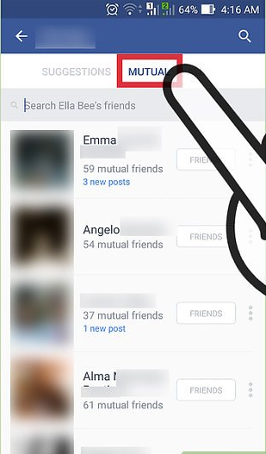
Analyzing mutual friendships with directed graphs
Mutual friends are the people who are Facebook friends with both you and the person whose profile you're viewing.

Slide 59
Graph API is used to access data for the authenticating user and the authenticating user’s friends.
mutualfriends API
Analysis of an ego graph for mutual friendships can be formulated using clique detection problem
Clique represent subset of all people who know each other

Slide 60
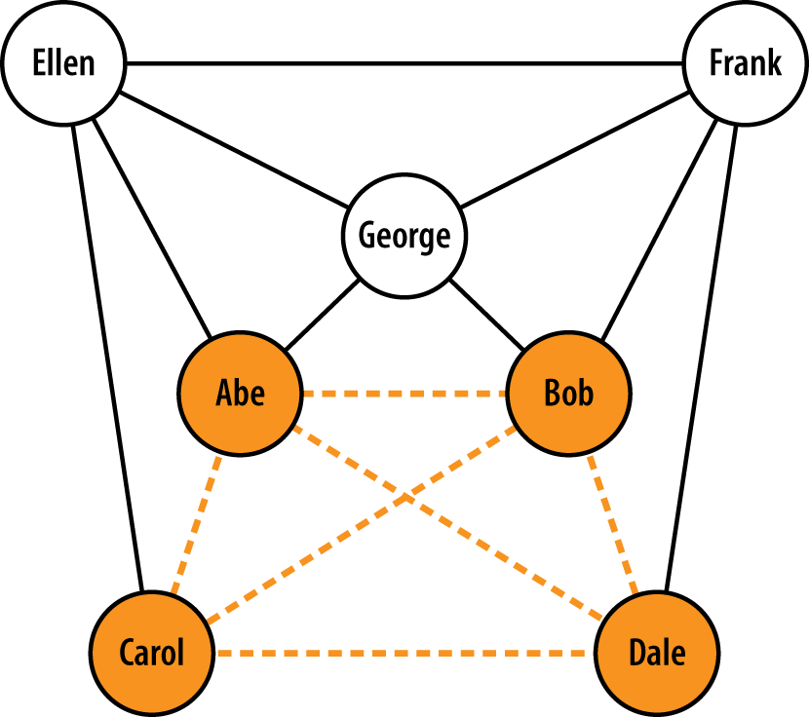
graph containing a maximum clique of size 4

Slide 61
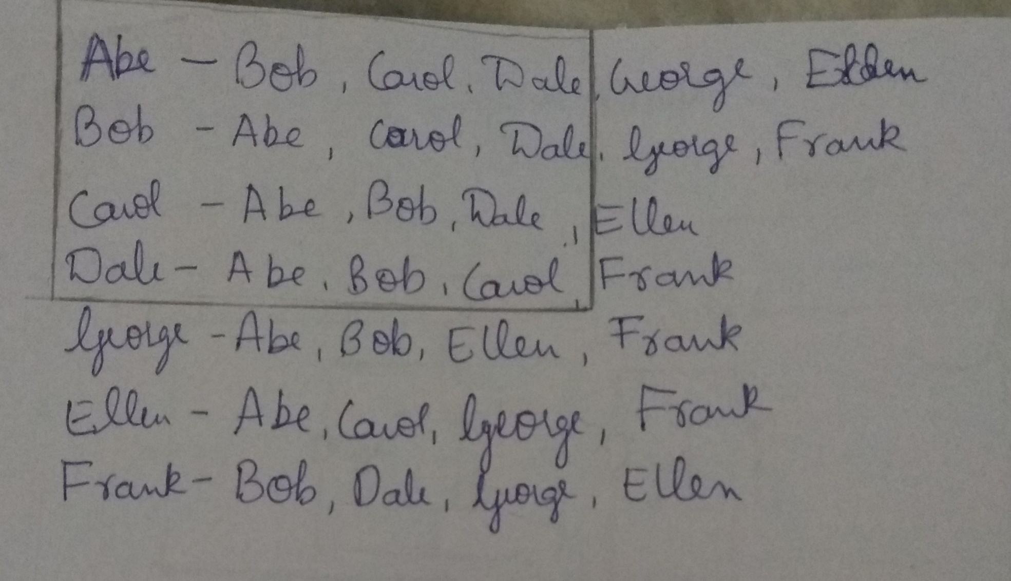

Slide 62
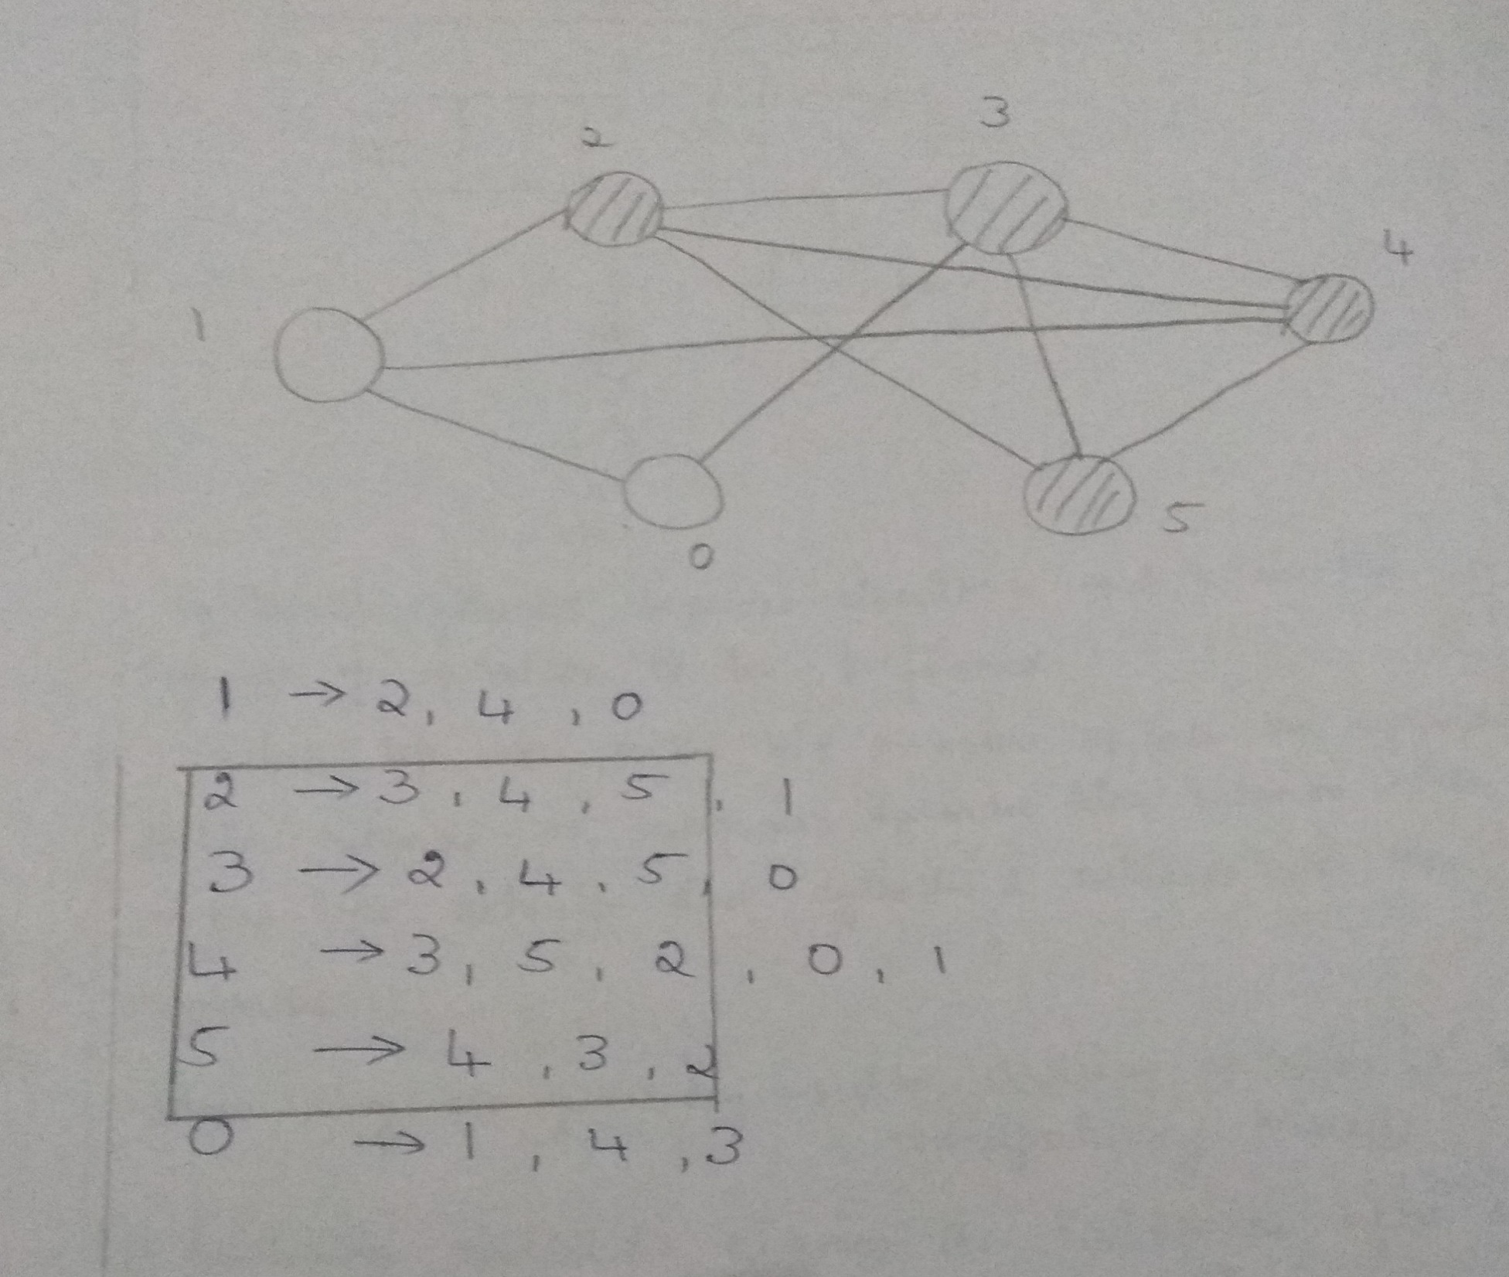

Slide 63
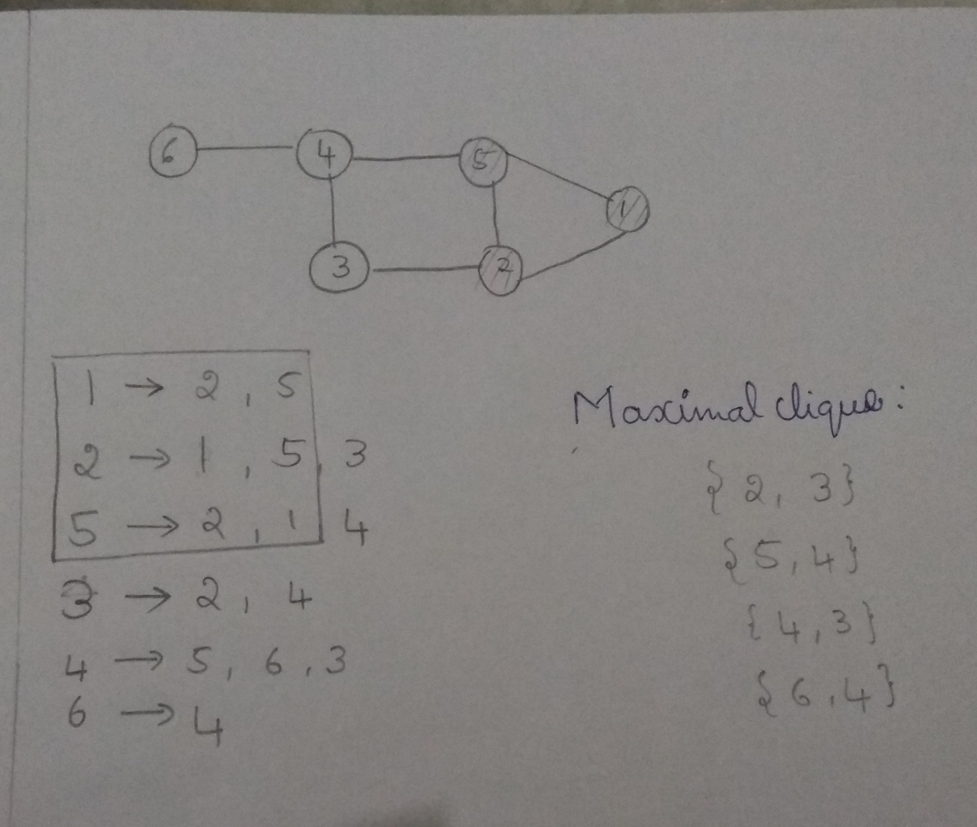

Slide 64
Given two social networks, comparing the sizes of the maximum friendship cliques provide a good starting point for analysis about various aspects of group dynamics.
NP complete problem
NetworkX package includes find_cliques method

Slide 65
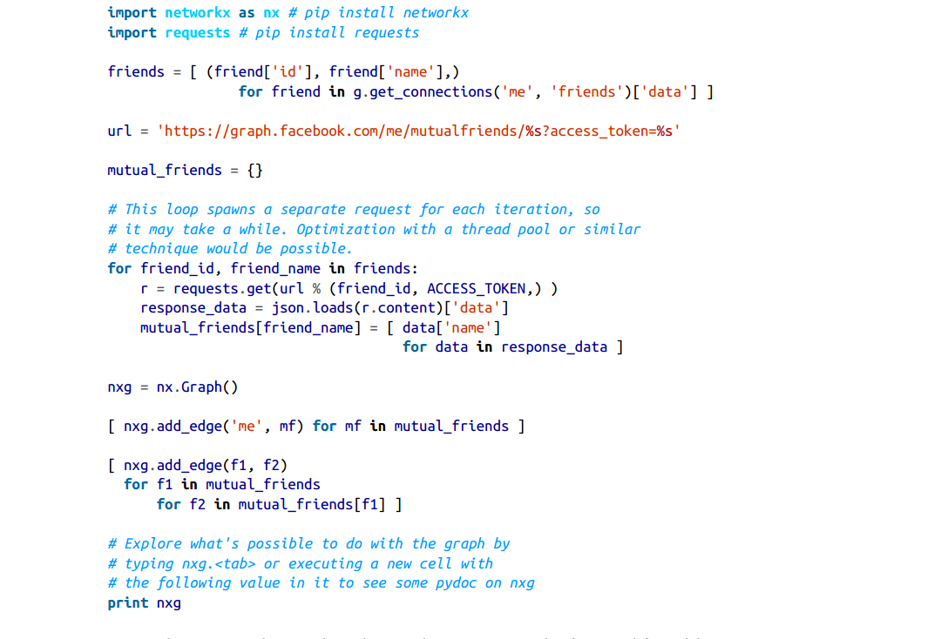
Constructing a graph of mutual friendships :

Slide 66
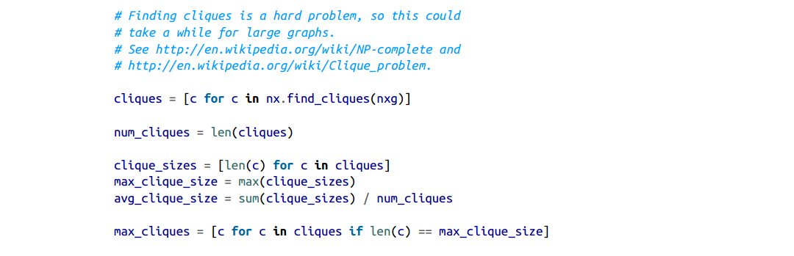
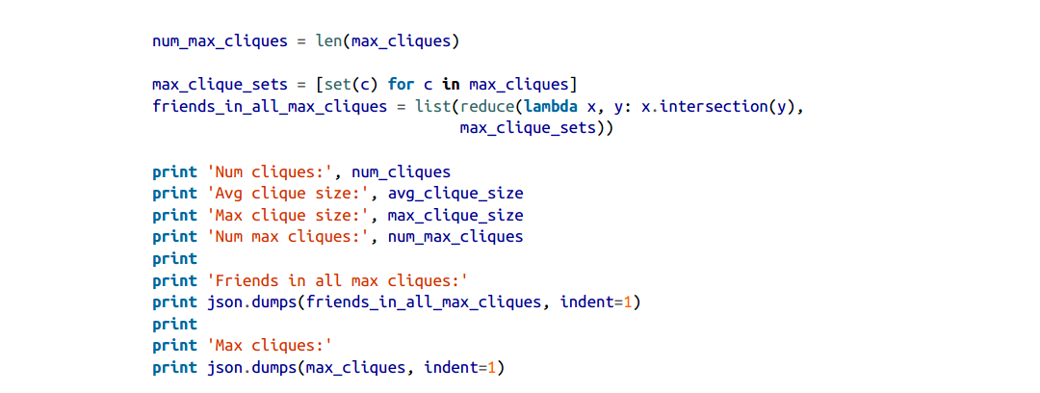
Finding and analyzing cliques in a graph of mutual friendships:

Slide 67
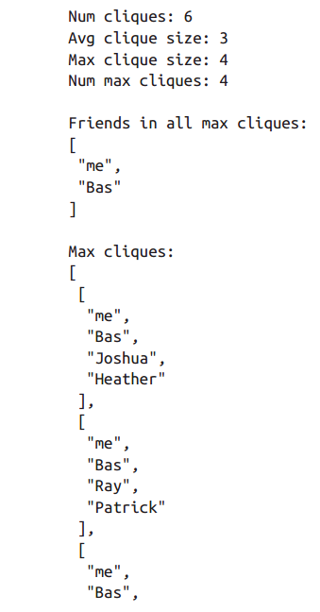
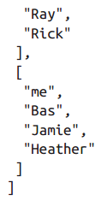

Slide 68
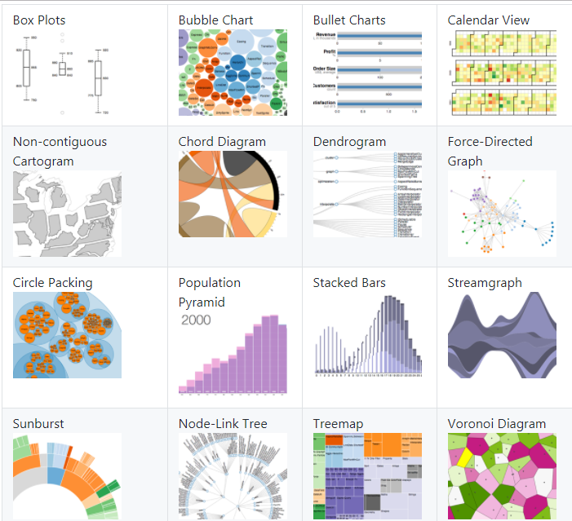
Visualizing directed graphs of mutual friendships
D3.js is a JavaScript toolkit that can render some beautiful visualizations in the browser.

Slide 69
A graph of mutual friendships within a Facebook social network

Slide 70
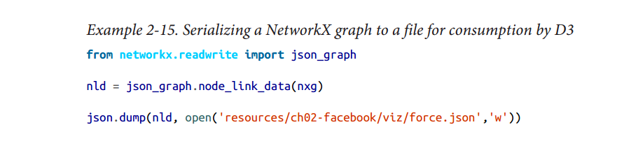

Slide 71
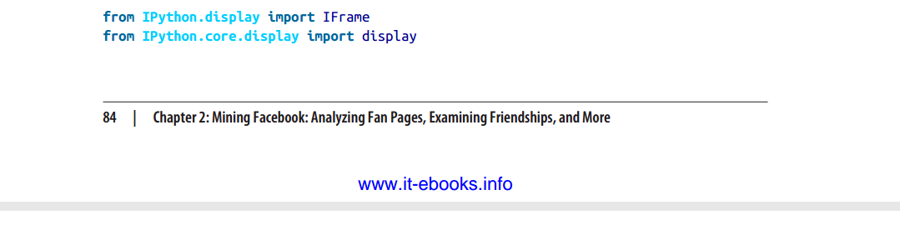
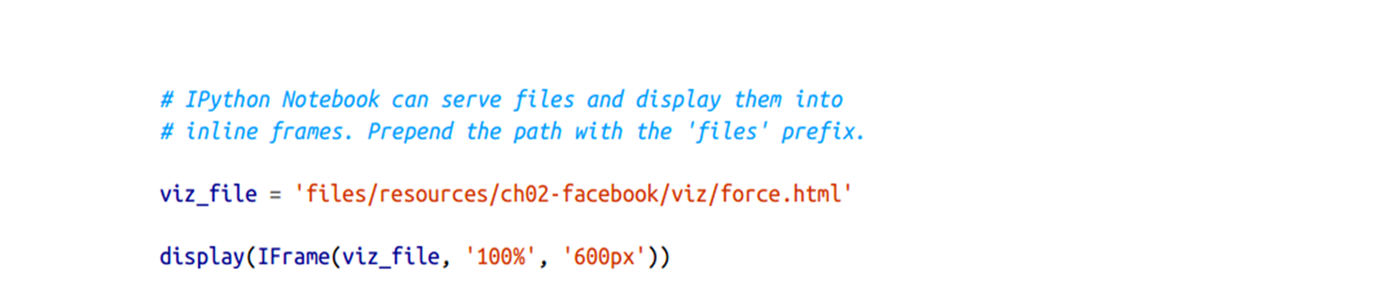
Visualizing a mutual friendship graph with D3:

Slide 72
CONCLUSION
To study about graph API
How open graph protocol create connection
How to programmatically query social graph

